Slide 1

France Housing Price Analytics
WEB SCRAPING – BIEN ICI
18 November 2020
Venkat JAYANARASIMHAN

Slide 2



Agenda
Introduction
Project Goal
Project Challenges
Product Demonstration
Methodology
Data Collection
Data Processing
Data Presentation

Slide 3

Project Goal And Challenges
Introduction

Slide 4




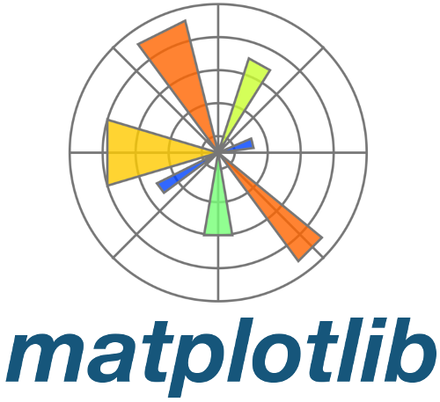

Project Goal
Where should you buy your dream Home?
Analysis and comparison of Housing prices in several cities in the North region of France using Web Scraping, Pandas data manipulation and Python data visualization techniques
Focus Cities: Tourcoing, Roubaix, Croix & Mouvaux
Packages Used:

Slide 5
Project Challenges
Bien Ici website is highly dynamic and consists of results in many pages, hence Beautiful Soup is not suitable for this application
Most of the variables were embedded in a single HTML element, hence even after scraping, heavy string manipulation is required
Dealing with missing values in key variables like Area (11 Nos)

Slide 6

Product Demonstration
Insights Analytics

Slide 7

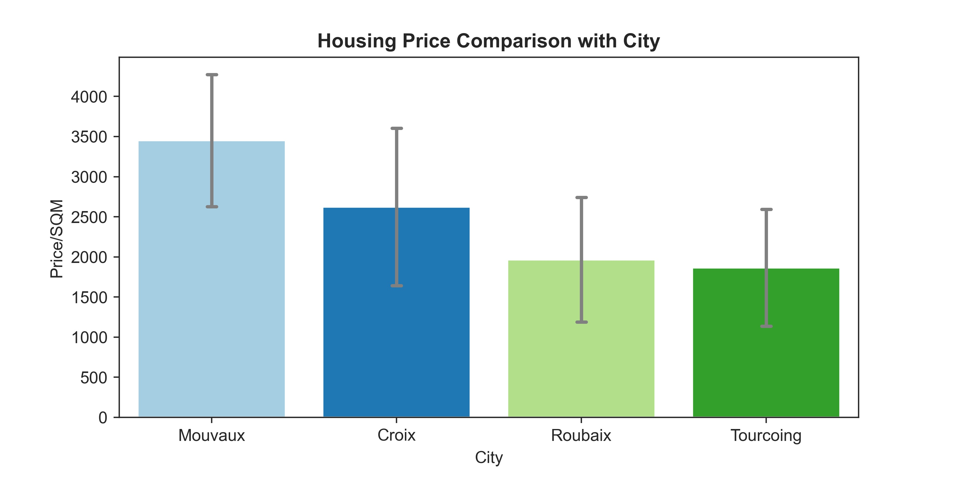
High Property Cost - Mouvaux & Croix

Slide 8
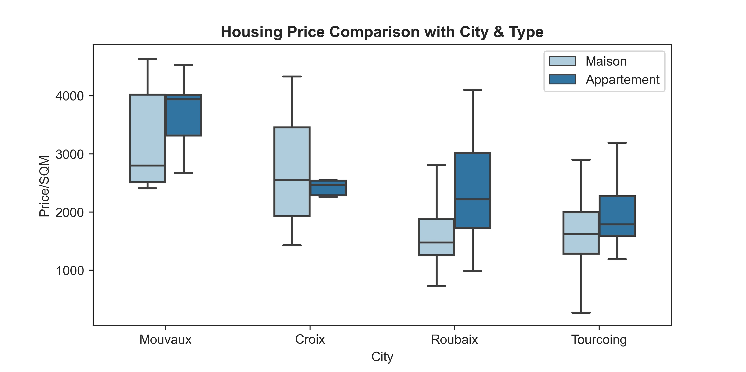
High Maison & Apart. Cost - Mouvaux
High Price | Maison | Apart.
Mouvaux | ⌂ | ⌂
Croix | ⌂
Roubaix |  | ⌂
Tourcoing | - | -

Slide 9
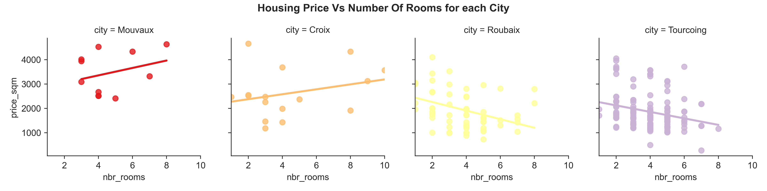
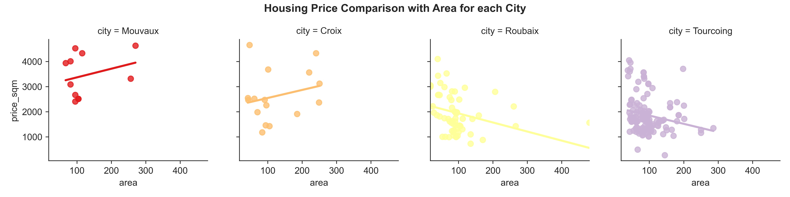
Price Increases with Rooms and Area

Slide 10
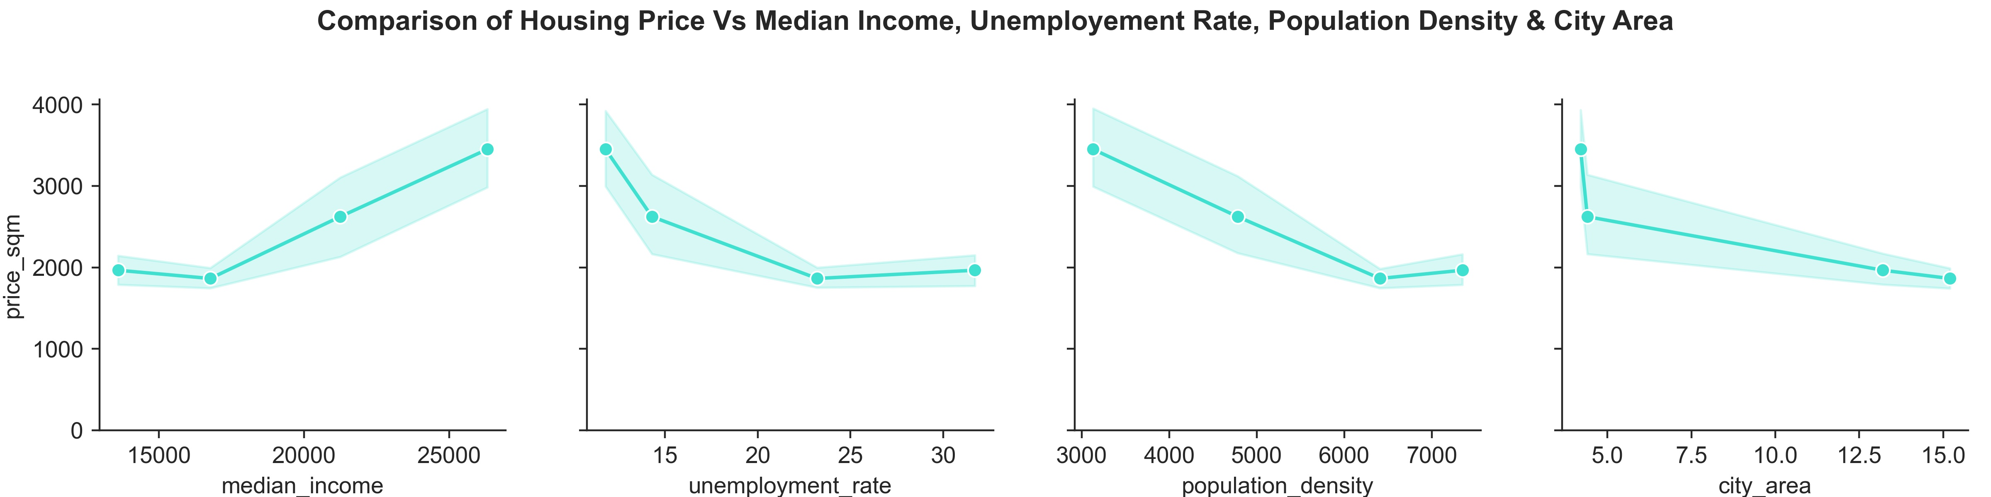
Demographics Highly Influences Price

Slide 11
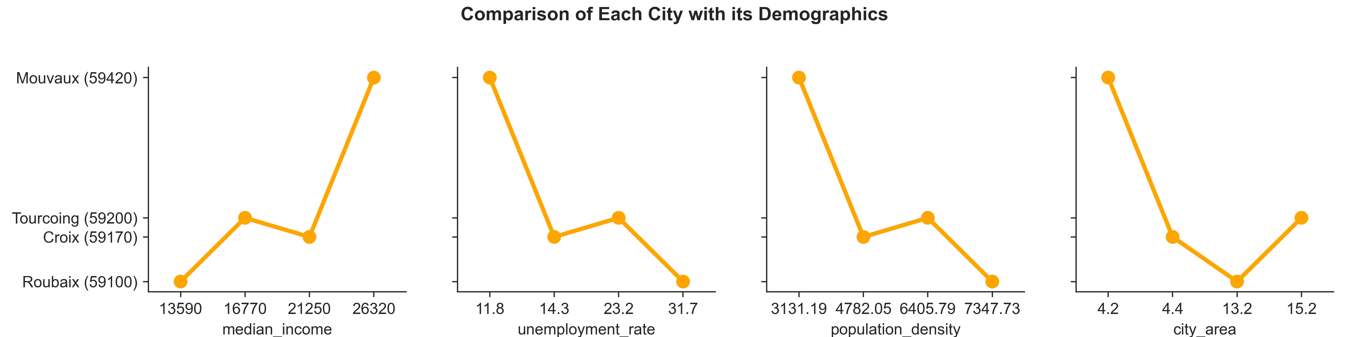
Better Demographics in Mouvaux

Slide 12
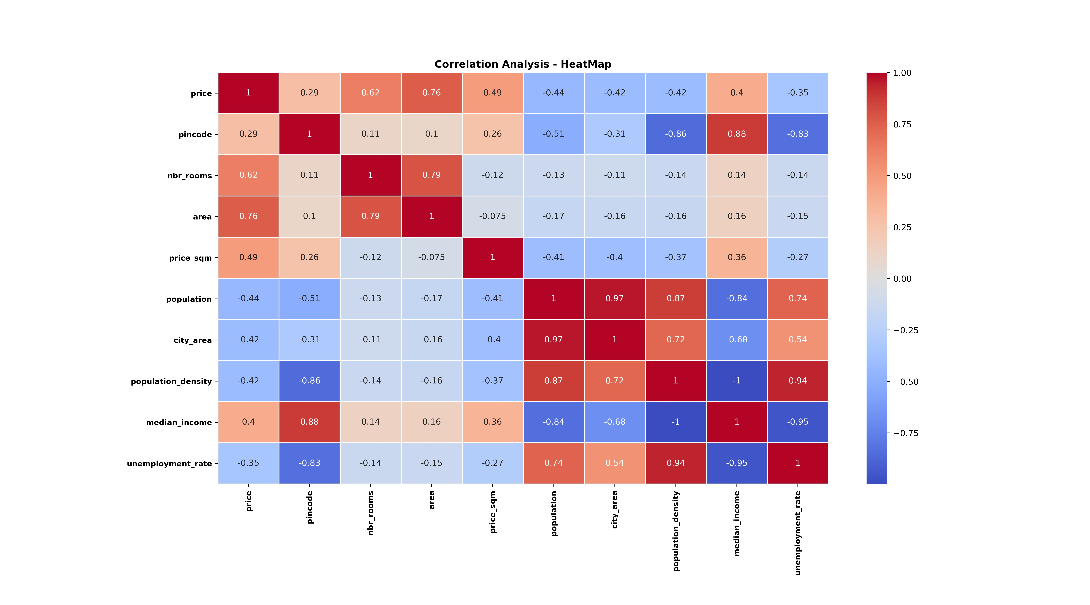
Price correlates with many features
 | Positive | Negative
Area | ⌂
Rooms | ⌂
Income | ⌂
Unemployment |  | ⌂
Population |  | ⌂
City Area |  | ⌂

Slide 13
Data Collection, Processing and Presentation
Methodology

Slide 14
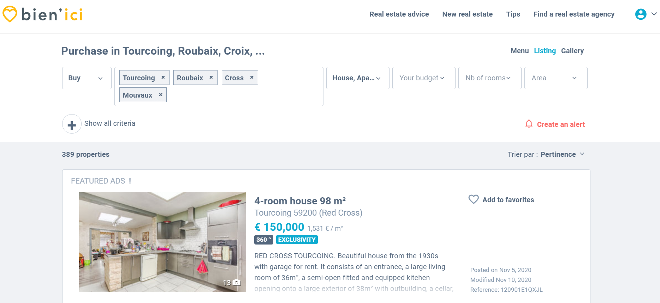
Website

Slide 15






Import Required Libraries
Data Collection
Selenium & Pandas
Set-Up Web Driver
Connect to Website
Defining Desired Browser & Driver Path
BienIci.com
Get Total Pages List
Get Information by Looping through each page
Use find elements by x_path and for loop
Use Empty Lists, For Loop & Append method
Housing Prices Data Set
Convert List → Dict. → Data Frame

Slide 16
Data Processing & Presenting
Data Processing
Data Presentation
Pandas
Handling Missing Values
Type Conversion
String Manipulation
NumPy
Creating Demographics Features as new columns in the Data Frame (np.where)
Matplotlib
Controlling the plot size, title, labels, tick marks
Seaborn
Generating different plots like Point, Line, Scatter, Bar, Box & Heat Map

Slide 17


Summary
Price Varies Based on Income
Price Varies Based on Demographics
Mouvaux is the expensive city for Housing
Roubaix & Tourcoing is the least expensive city for Housing

Slide 18

Thank You
Any Questions?

